Slide 1

NPTEL Mentor chosen steps

Slide 2
STEP-1
Visit the below link https://onlinecourses.nptel.ac.in/

Slide 3
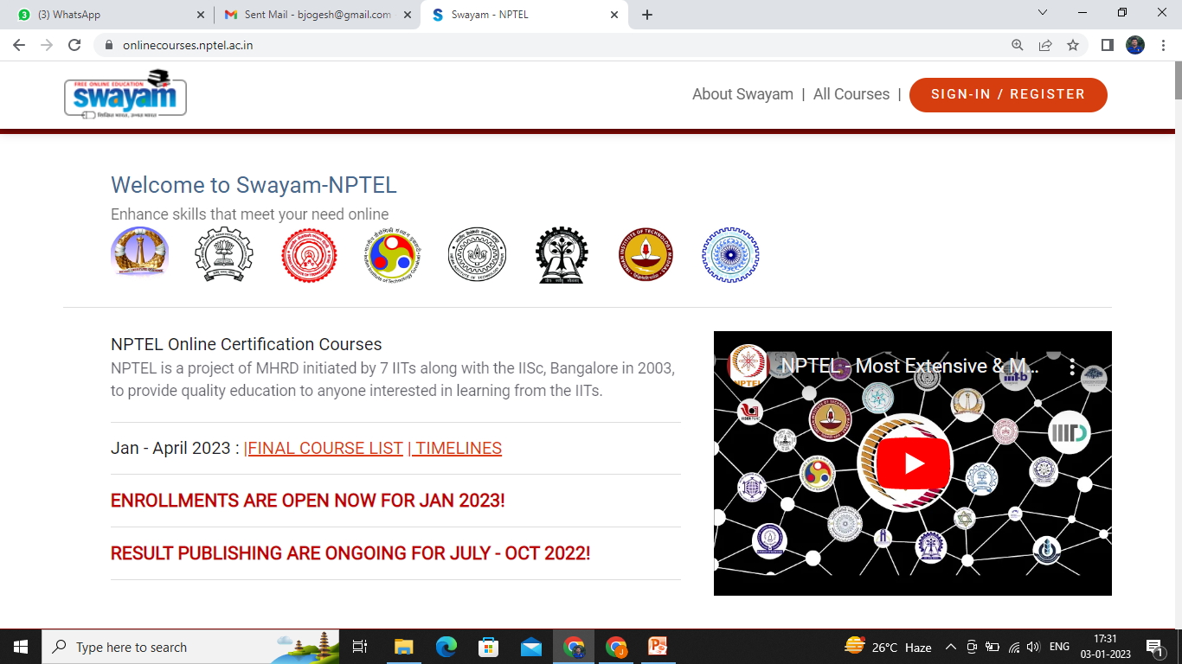
STEP-2
Login with your credentials

Slide 4
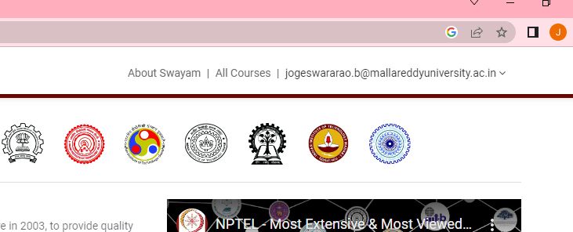
STEP-3
Click on your email id

Slide 5
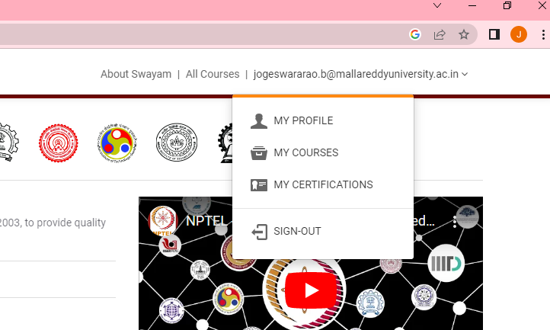
STEP-4
Click on ‘MY COURSES ‘

Slide 6
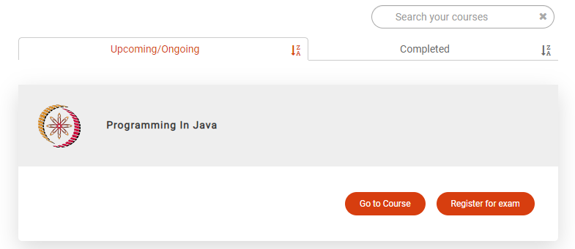
STEP-5
Click on “Go to Course”

Slide 7
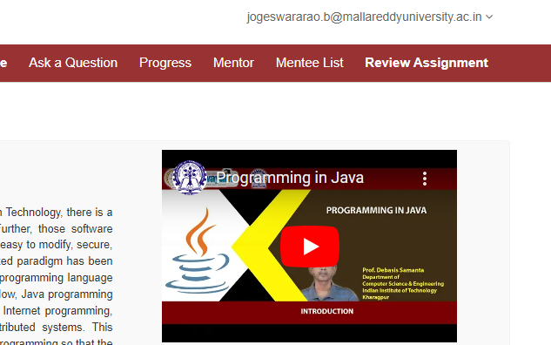
STEP-6
Click on “Mentor”

Slide 8
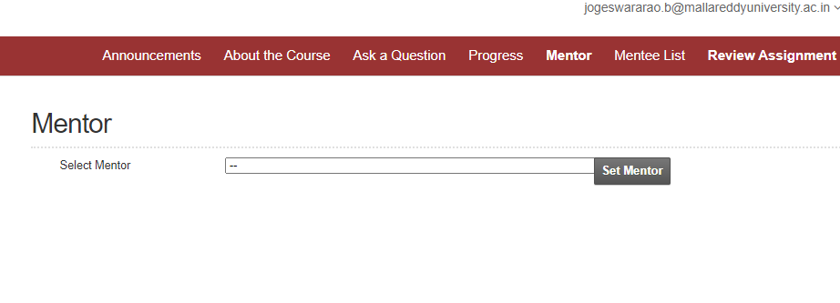
STEP-7
Click on “Select Mentor” and Pick Mentor as a “M.Shailaja” from top down list

Slide 9
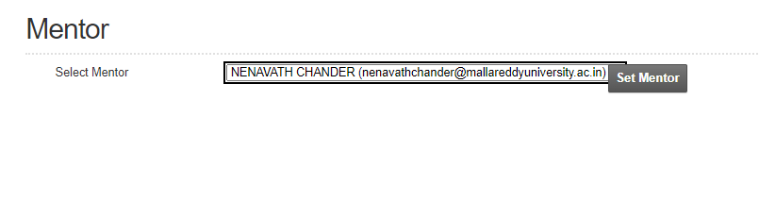
STEP-8
Click on “Set Mentor”

Slide 10
Please check Your Mentor Name is correct or not? again login in portal and check Your Mentor Name .

Slide 11
Thank you….

